Slide 1

Chapter 5
Defining Classes II
Slides prepared by Rose Williams, Binghamton University
Kenrick Mock, University of Alaska Anchorage
Copyright © 2016 Pearson Inc. All rights reserved.

Slide 2
Static Methods
A static method is one that can be used without a calling object
A static method still belongs to a class, and its definition is given inside the class definition
When a static method is defined, the keyword static is placed in the method header
  public static returnedType myMethod(parameters)
  { . . . }
Static methods are invoked using the class name in place of a calling object
  returnedValue = MyClass.myMethod(arguments);

Slide 3
Pitfall: Invoking a Nonstatic Method Within a Static Method
A static method cannot refer to an instance variable of the class, and it cannot invoke a nonstatic method of the class
  A static method has no this, so it cannot use an instance variable or method that has an implicit or explicit this for a calling object
  A static method can invoke another static method, however

Slide 4
Static Variables
A static variable is a variable that belongs to the class as a whole, and not just to one object
  There is only one copy of a static variable per class, unlike instance variables where each object has its own copy
All objects of the class can read and change a static variable
Although a static method cannot access an instance variable, a static method can access a static variable
A static variable is declared like an instance variable, with the addition of the modifier static
    private static int myStaticVariable;

Slide 5
Static Variables
Static variables can be declared and initialized at the same time
    private static int myStaticVariable = 0;
If not explicitly initialized, a static variable will be automatically initialized to a default value
  boolean static variables are initialized to false
  Other primitive types static variables are initialized to the zero of their type
  Class type static variables are initialized to null
It is always preferable to explicitly initialize static variables rather than rely on the default initialization

Slide 6
Static Variables
A static variable should always be defined private, unless it is also a defined constant
  The value of a static defined constant cannot be altered, therefore it is safe to make it public
  In addition to static, the declaration for a static defined constant must include the modifier final, which indicates that its value cannot be changed
  public static final int BIRTH_YEAR = 1954;
When referring to such a defined constant outside its class, use the name of its class in place of a calling object
    int year = MyClass.BIRTH_YEAR;

Slide 7
The Math Class
The Math class provides a number of standard mathematical methods
  It is found in the java.lang package, so it does not require an import statement
  All of its methods and data are static, therefore they are invoked with the class name Math instead of a calling object
  The Math class has two predefined constants, E (e, the base of the natural logarithm system) and PI (π, 3.1415 . . .)
    area = Math.PI * radius * radius;

Slide 8
Variables and Memory
A computer has two forms of memory
Secondary memory is used to hold files for "permanent" storage
Main memory is used by a computer when it is running a program
  Values stored in a program's variables are kept in main memory

Slide 9
Variables and Memory
Main memory consists of a long list of numbered locations called bytes
  Each byte contains eight bits: eight 0 or 1 digits
The number that identifies a byte is called its address
  A data item can be stored in one (or more) of these bytes
  The address of the byte is used to find the data item when needed

Slide 10
Variables and Memory
Values of most data types require more than one byte of storage
  Several adjacent bytes are then used to hold the data item
  The entire chunk of memory that holds the data is called its memory location
  The address of the first byte of this memory location is used as the address for the data item
A computer's main memory can be thought of as a long list of memory locations of varying sizes

Slide 11
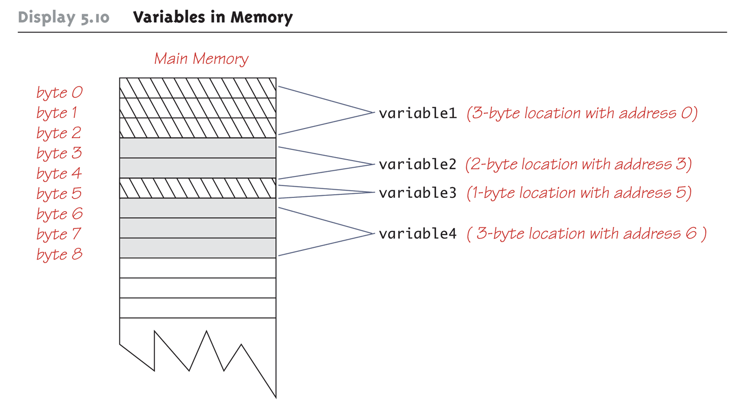
Variables in Memory

Slide 12
References
Every variable is implemented as a location in computer memory
When the variable is a primitive type, the value of the variable is stored in the memory location assigned to the variable
  Each primitive type always require the same amount of memory to store its values

Slide 13
References
When the variable is a class type, only the memory address (or reference) where its object is located is stored in the memory location assigned to the variable
  The object named by the variable is stored in some other location in memory
  Like primitives, the value of a class variable is a fixed size
  Unlike primitives, the value of a class variable is a memory address or reference
  The object, whose address is stored in the variable, can be of any size

Slide 14
References
Two reference variables can contain the same reference, and therefore name the same object
  The assignment operator sets the reference (memory address) of one class type variable equal to that of another
  Any change to the object named by one of theses variables will produce a change to the object named by the other variable, since they are the same object
    variable2 = variable1;

Slide 15
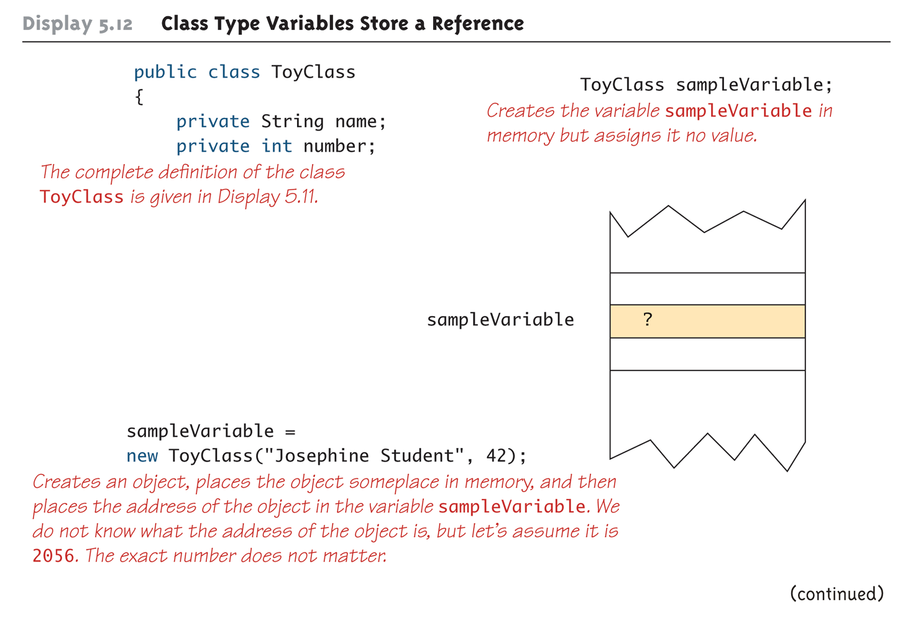
Class Type Variables Store a Reference (Part 1 of 2)

Slide 16
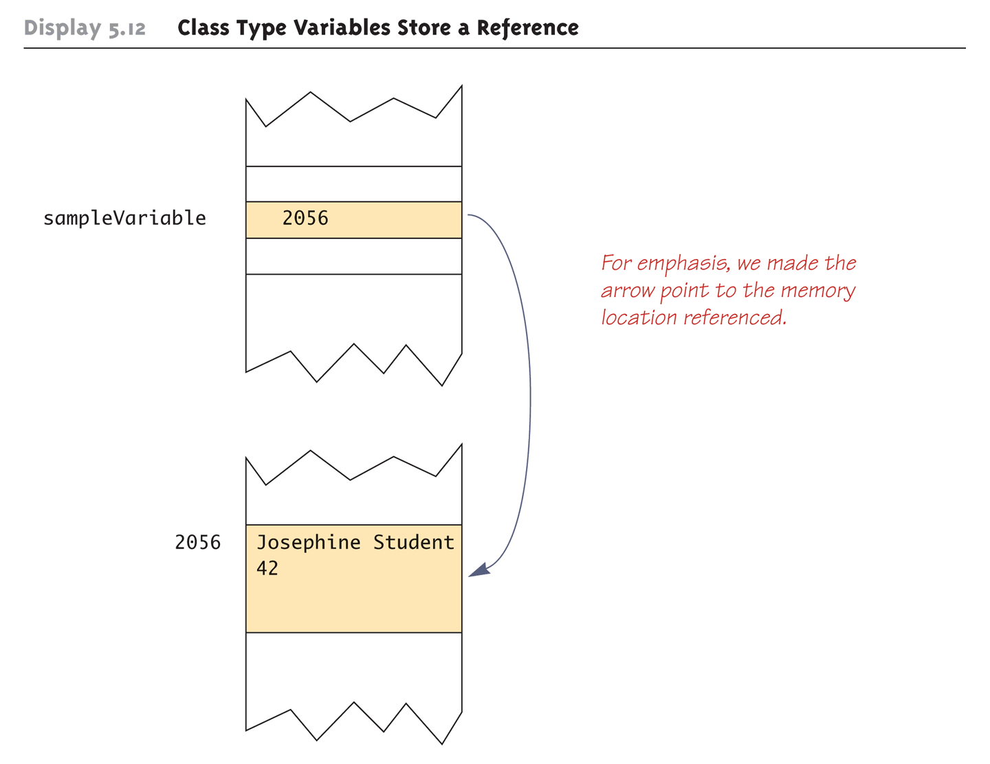
Class Type Variables Store a Reference (Part 2 of 2)

Slide 17
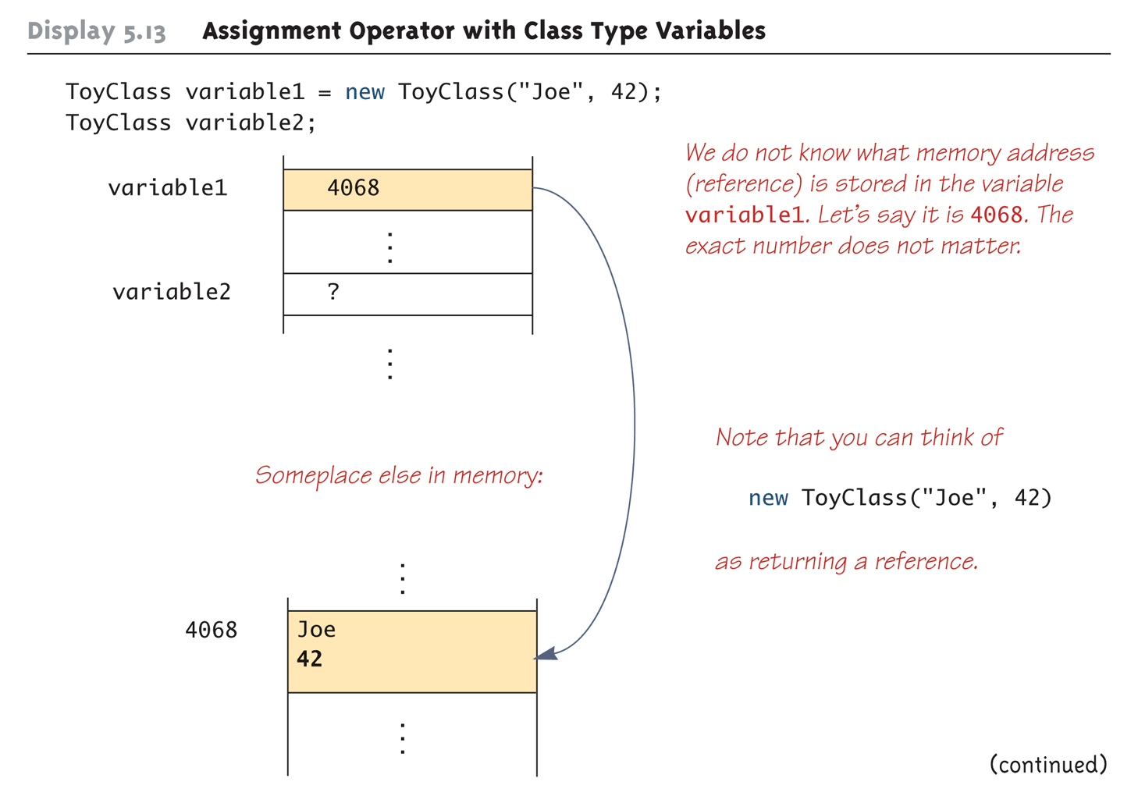
Assignment Operator with Class Type Variables (Part 1 of 3)

Slide 18
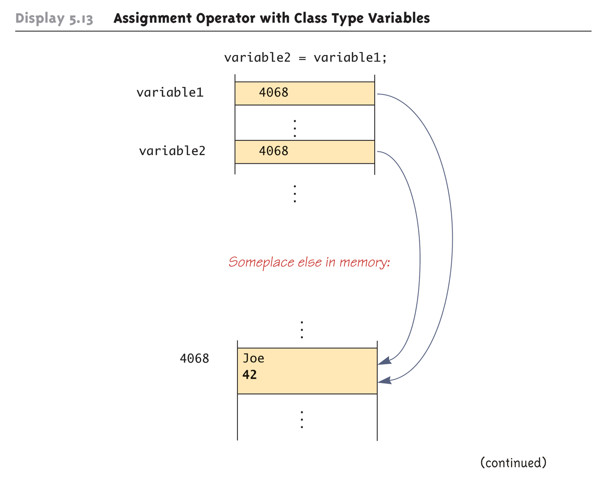
Assignment Operator with Class Type Variables (Part 2 of 3)

Slide 19
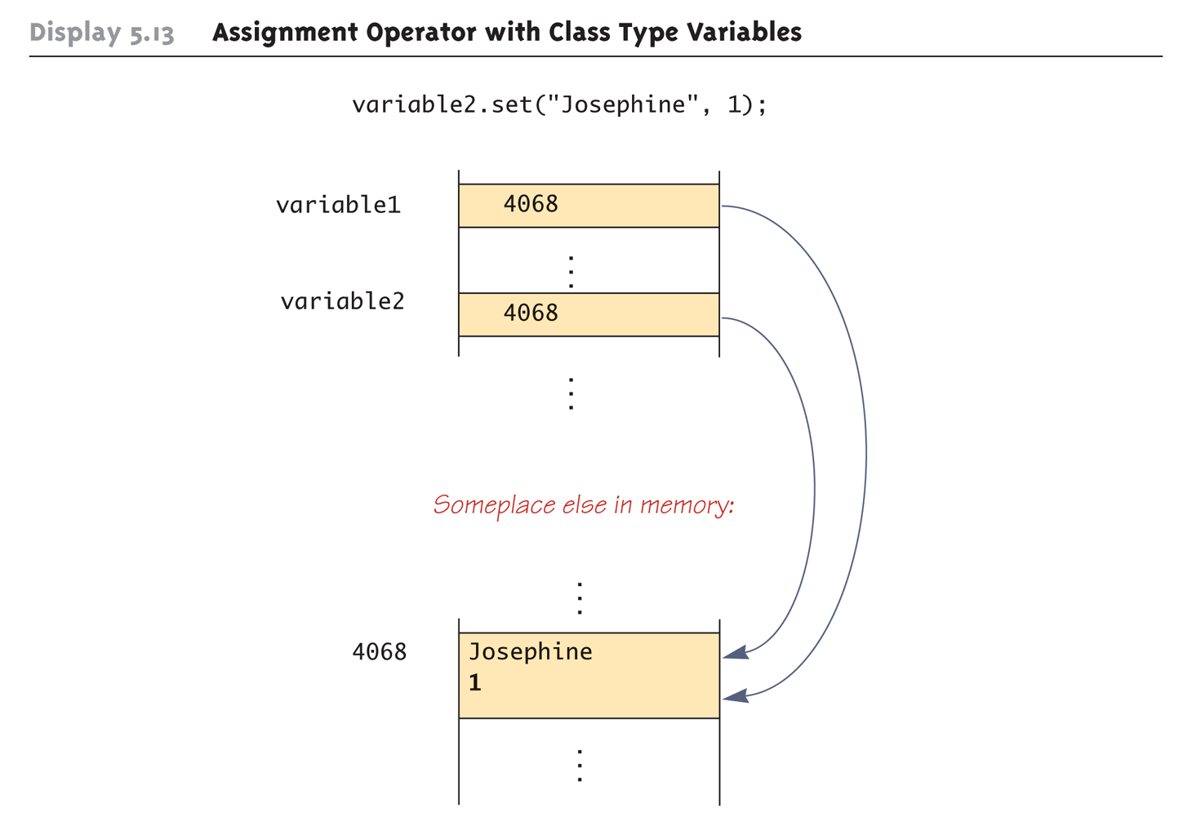
Assignment Operator with Class Type Variables (Part 3 of 3)

Slide 20
Class Parameters
All parameters in Java are call-by-value parameters
  A parameter is a local variable that is set equal to the value of its argument
  Therefore, any change to the value of the parameter cannot change the value of its argument
Class type parameters appear to behave differently from primitive type parameters
  They appear to behave in a way similar to parameters in languages that have the call-by-reference parameter passing mechanism

Slide 21
Class Parameters
The value plugged into a class type parameter is a reference (memory address)
  Therefore, the parameter becomes another name for the argument
  Any change made to the object named by the parameter (i.e., changes made to the values of its instance variables) will be made to the object named by the argument, because they are the same object
  Note that, because it still is a call-by-value parameter, any change made to the class type parameter itself (i.e., its address) will not change its argument (the reference or memory address)

Slide 22
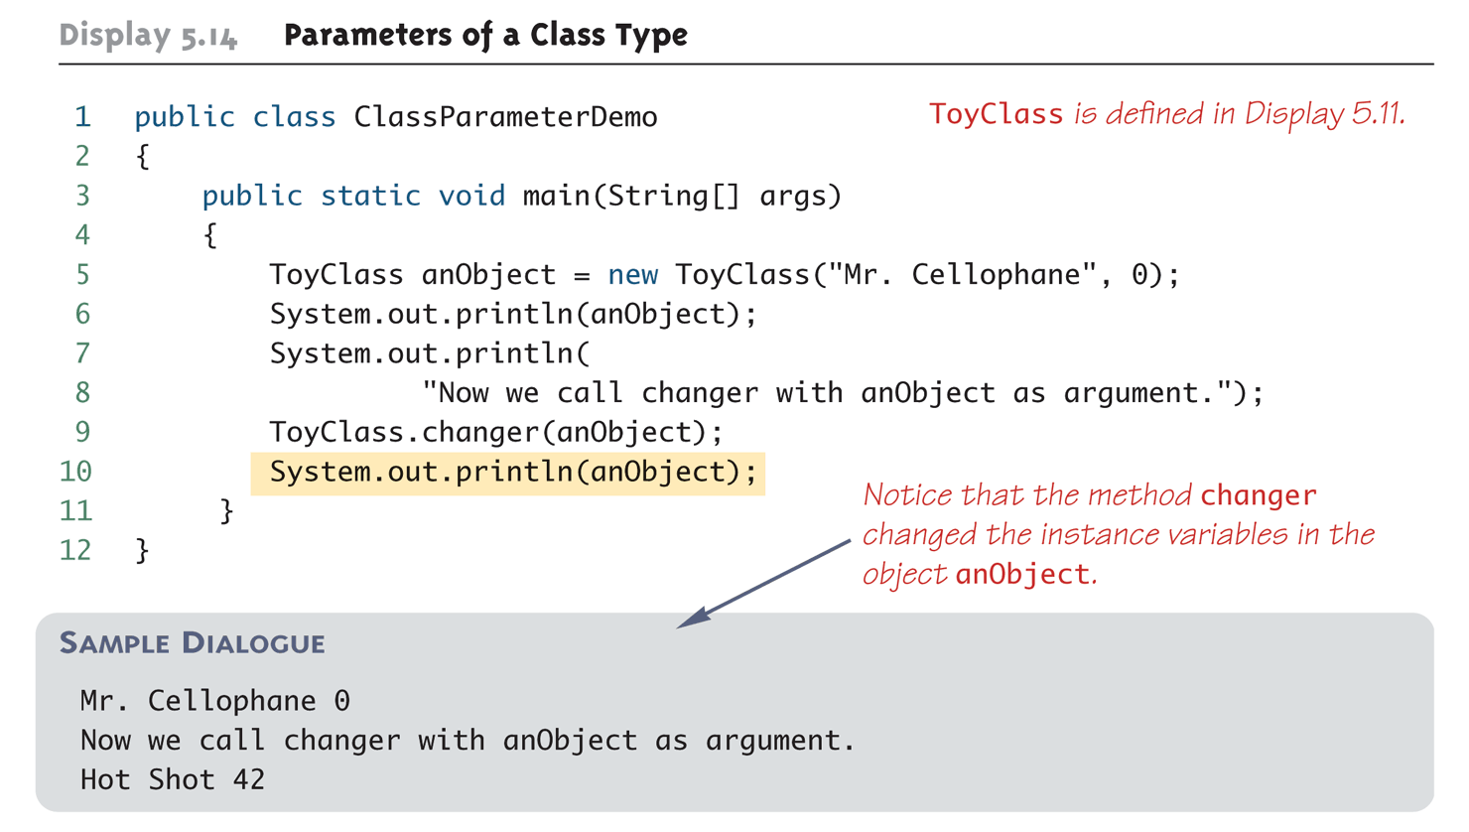
Parameters of a Class Type

Slide 23
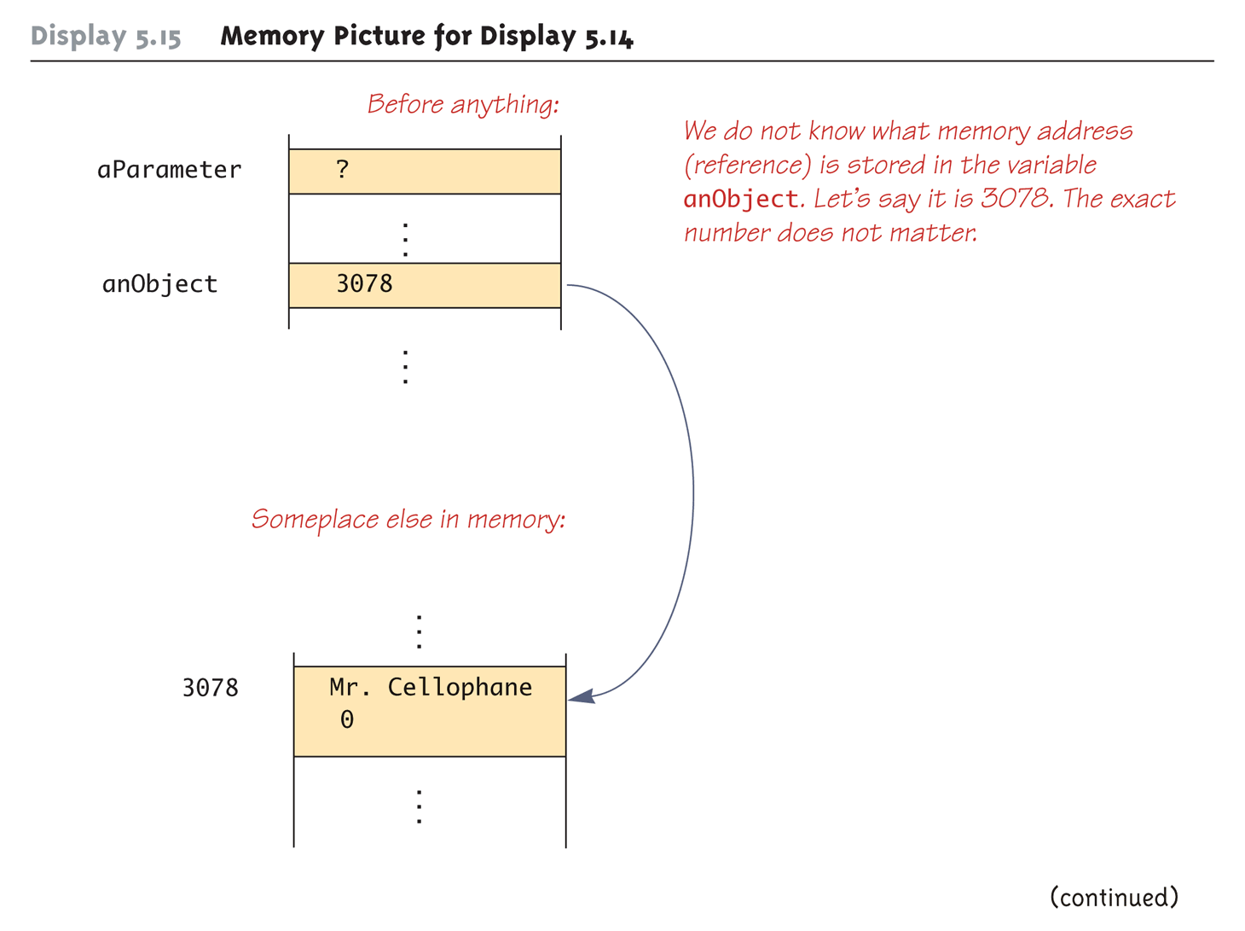
Memory Picture for Display 5.14
(Part 1 of 3)

Slide 24
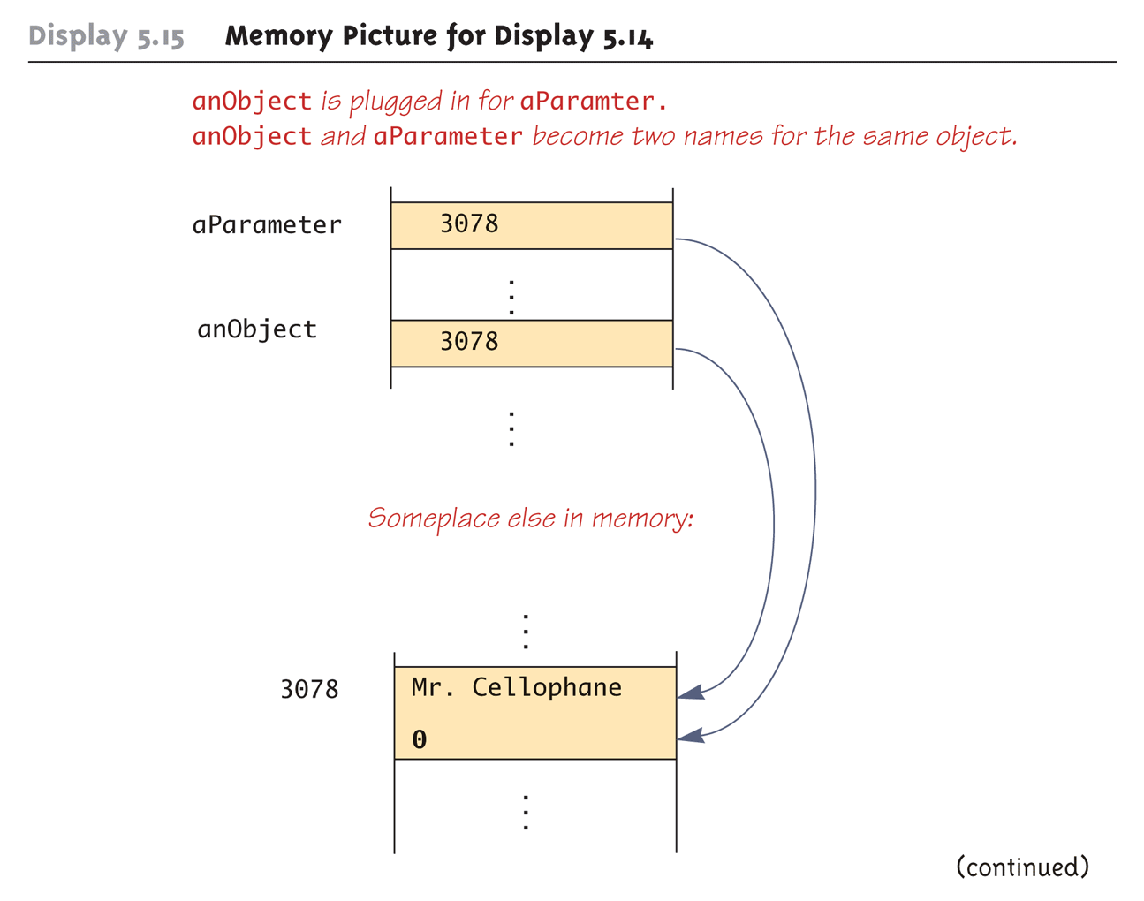
Memory Picture for Display 5.14
(Part 2 of 3)

Slide 25
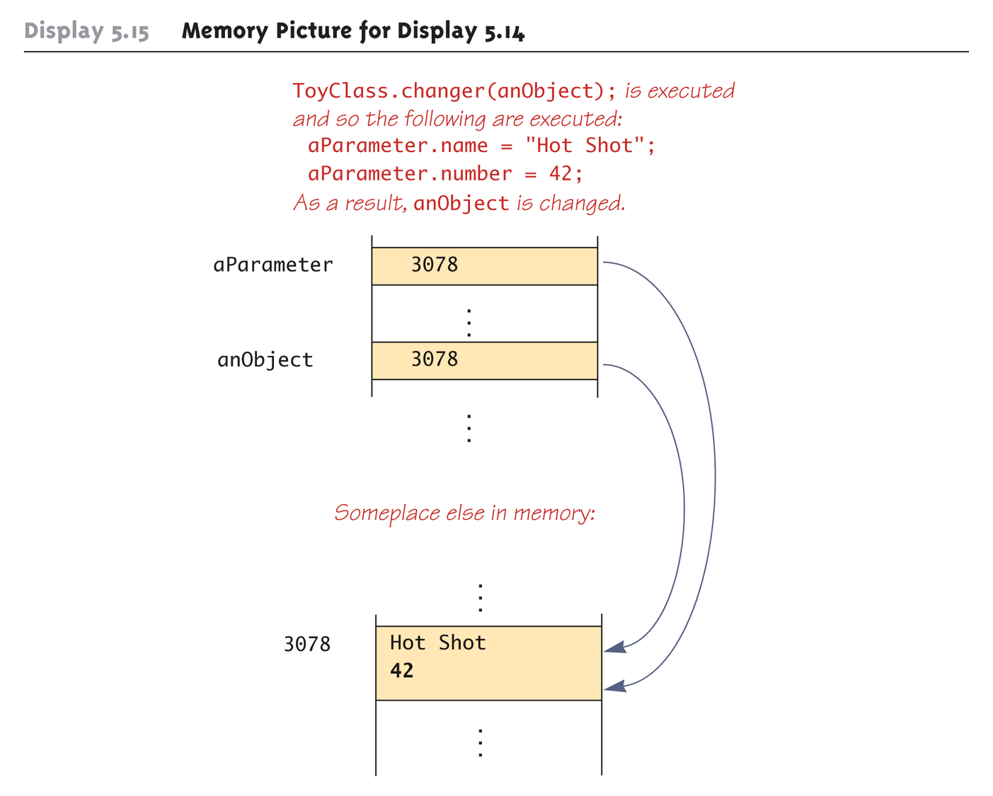
Memory Picture for Display 5.14
(Part 3 of 3)

Slide 26
Differences Between Primitive and Class-Type Parameters
A method cannot change the value of a variable of a primitive type that is an argument to the method
In contrast, a method can change the values of the instance variables of a class type that is an argument to the method

Slide 27
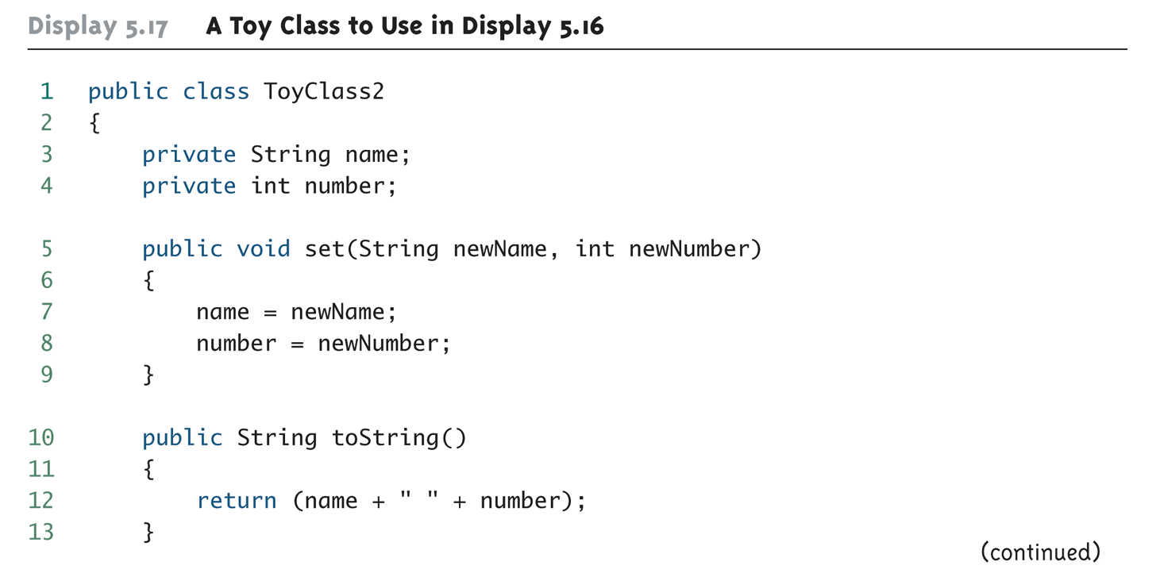
A Toy Class to Use in Display 5.16
(Part 1 of 2)

Slide 28
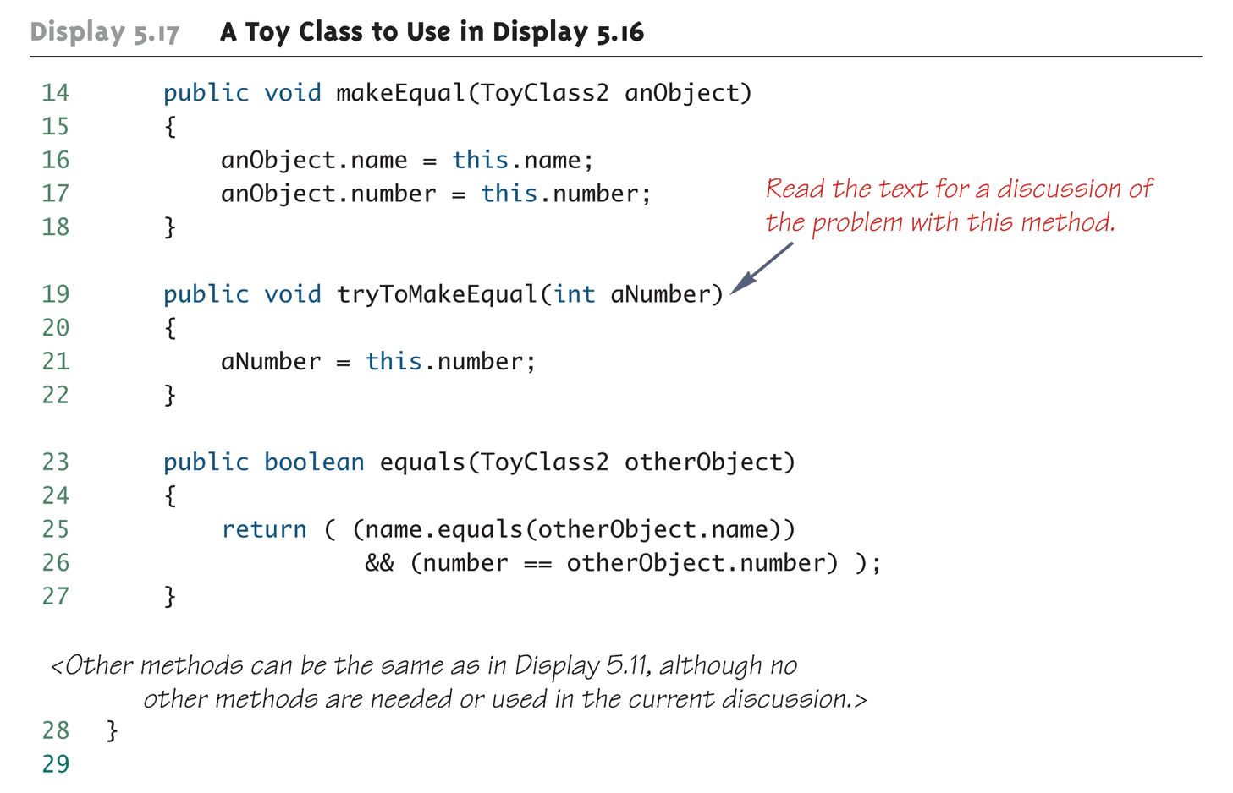
A Toy Class to Use in Display 5.16
(Part 2 of 2)

Slide 29
Pitfall: Use of = and == with Variables of a Class Type
Used with variables of a class type, the assignment operator (=) produces two variables that name the same object
  This is very different from how it behaves with primitive type variables
The test for equality (==) also behaves differently for class type variables
  The == operator only checks that two class type variables have the same memory address
  Unlike the equals method, it does not check that their instance variables have the same values
  Two objects in two different locations whose instance variables have exactly the same values would still test as being "not equal"

Slide 30
The Constant null
null is a special constant that may be assigned to a variable of any class type
    YourClass yourObject = null;
It is used to indicate that the variable has no "real value"
  It is often used in constructors to initialize class type instance variables when there is no obvious object to use
null is not an object: It is, rather, a kind of "placeholder" for a reference that does not name any memory location
  Because it is like a memory address, use == or != (instead of equals) to test if a class variable contains null
    if (yourObject == null) . . .

Slide 31
The new Operator and Anonymous Objects
The new operator invokes a constructor which initializes an object, and returns a reference to the location in memory of the object created
  This reference can be assigned to a variable of the object's class type
Sometimes the object created is used as an argument to a method, and never used again
  In this case, the object need not be assigned to a variable, i.e., given a name
An object whose reference is not assigned to a variable is called an anonymous object

